Slide 1







USAID Social and
Behavior Change Activity
Family Health Creative Brief
October 2021

Slide 2
Background / Situation Analysis
The family health components (Family Planning, Nutrition & WASH, Malaria, MCH) are closely interlinked and have the same priority audiences as indicated by the data below.
    MCH – uptake of ANC in the first trimester (33%), uptake of postnatal care within 6 weeks (25%-30%), low uptake of full vaccination services for children by one year (55%), pneumonia, diarrhea and malaria are leading childhood diseases.
    Nutrition – Anemia (3/10 Women of Reproductive Age - WRA), early initiation to breastfeeding (6/10), exclusive breastfeeding (6/10), minimum acceptable diet – inadequate complementary feeding (only 14%), anemia (5/10 children under 5), almost 3/10 children under 5 are stunted.
    Malaria – IPTp uptake during pregnancy (55.4%), prevalence highest among children under 5, treatment protocols not followed, net usage in specific areas (60% for children under 5 & 65% pregnant women but lower for certain regions) , low risk perception around malaria.
    Family Planning – high adolescent pregnancy (25%), low FP uptake among 15–19-year-olds, low uptake of PPFP, myths and misconceptions, fear of side effects, poor provider attitudes - Unmet need is still high 28%, MCPR 38%.
The four thematic areas above cut across four priority audiences including adolescent girls (10-14) not yet pregnant, pregnant adolescent girls (10-14), AGYWs of low parity (15-24) and men.
The determinants of Family Health status are largely context specific and hinged on social and cultural norms; perception of FH issues as a female responsibility being the most prominent as evidenced by minimal male involvement.
Although men seem not to be affected, they play a critical role in the adoption of the recommended FH services. Therefore, should be treated as a key audience as well.

Slide 3
Goal & Objectives
Goal
To contribute to the improvement of maternal and child health and productivity of both urban and rural families in Uganda.
Objectives
Empower adolescent girls, women and men with knowledge and skills to prevent unplanned pregnancy.
Equip adolescent girls, women and men with knowledge and skills to prevent complications during pregnancy and childbirth.
Create awareness on recognition and management of common childhood illnesses.
Address barriers of LLIN use, increase risk perception and promote timely treatment for malaria.
Increase knowledge and skills on how to have a healthy diet among mothers and children.
Empower health workers to address individual barriers towards practice of the recommended family health behaviors.
Equip gate keepers with knowledge and skills to challenge barriers of family health at individual, societal and structural level.

Slide 4
Competitive Behaviors / Barriers – Family Planning – AGYWs (15-24)
Information: There is limited knowledge on how FP methods work. There is limited contact with health workers and champions who are credible sources of information on FP. Women access FP information from peers.
Motivation: There are fear of side effects, myths, and misconceptions of infertility or slow return to fertility, cancerous growth, birth defects, pregnancy, and miscarriage. Negative peer influence (recommending wrong pregnancy prevention methods).
Ability to Act: There is lack of spouse/partner support or fear of consequences from a partner. Limited available FP options at the facility. Lack of skills to negotiate contraceptive use.
Norms: Children are a blessing and a sign of wealth/status in the community, hence there is no need to limit them through FP. Perception that FP is only for women.

Slide 5
Competitive Behaviors / Barriers – Family Planning – Adolescent Girls (10-14)
Information: Limited access to correct FP information and services. Most information comes from peers. Inadequate knowledge about safe days and how they work to prevent pregnancy. Naivety about body changes.
Motivation: There are fear of side effects and the prevailing myths, and misconceptions about FP and pregnancy prevention. Unfriendly health care services and the fear to be judged. Peer pressure to start sex early and have many partners. Negative peer influence (recommending wrong pregnancy prevention methods). The perception that a man will love them more and they will have more control on the man if they give birth.
Ability to Act: Lack of candid and open dialogue on sexuality with parents or caretakers. Parents/teachers talk about sexuality in parables and indirectly. Services are often far away. Strong emotional and sexual urge that impairs judgment and leads to wrong decisions.
Norms: Teenagers should not have sex and hence cannot freely buy or be seen with condoms. Stigma associated with FP use at school and in the community. Sexuality talks focus on the girls more than boys. Condoms are seen as a sign of promiscuity.

Slide 6
Competitive Behaviors / Barriers – Antenatal Care (ANC) Attendance
Information: Limited knowledge about the benefits of early and full ANC. People receive information and “advice” from family members, friends, and peers, who have gaps as well.
Motivation: Belief that if a woman does not experience any problem during pregnancy, there is no need to go for ANC or deliver at a health center. There is also fear of HIV testing during ANC and receiving results. Pill burden and side-effects related to SP, & folic acid. Presence of older women who discourage pregnant women from early ANC attendance and encourage them to use herbs during pregnancy. The long waiting time at the health facility. Bias of previous record of non-ANC attendance. Belief that if one goes for ANC early, they will get tired quickly before they are due for childbirth. Fear of shame in case of a miscarriage if one goes for ANC early. Poor engagement of men at the facility.
Ability to Act: Availability of herbal options and traditional birth attendants (TBAs) in the community who are nearer than health centers. There is lack of partner support to go for ANC and give birth to a healthy child. Hence, there no need to return to the health center. The financial implications tagged to ANC attendance (transport and kaveera).
Norms: Child-bearing is considered a woman’s business and hence there is no male partner support. There is also a belief that traditional options (e.g., herbs), TBAs and advice from elders have been effective over the years for many women in the community.

Slide 7
Competitive Behaviors / Barriers - Immunization
Information: Low knowledge levels and awareness about the importance of full child immunization. Inadequate knowledge about the number of vaccination shots.
Motivation: Suspicion about immunization (e.g., vaccines cause physical disability and/or death). Negative experiences at the facility e.g., being scolded for forgetting the child health card.
Ability to Act: Lack of partner support. Absence of an immunization card, which is a requirement for having an immunization - this is related to not delivering at a health center. Lack of history of ANC attendance and health facility delivery. Inappropriate schedule of immunization services for both facilities and outreaches e.g., contradicting with market days. Long distance to the facility.
Norm: Community belief that immunization is not necessary, due to the existence of un-immunized healthy individuals in the community. Perception that immunization is solely a woman’s responsibility.

Slide 8
Competitive Behaviors / Barriers – Maternal Nutrition
Information: Lack of knowledge on dietary diversity that exist in various communities, inadequate knowledge on preparation of nutritious food combinations. Lack of knowledge on the benefits of proper nutrition before, during and after pregnancy.
Motivation: Food preference, tastes, and existence of stable foods in various communities. The belief that locally available foods (e.g., greens and fruits) are not good enough and are for poor people.
Ability to act: Lack of partner support for money to buy nutritious foods.
Norms: Perception that maternal health is solely a woman’s responsibility, food taboos (e.g., women should not eat chicken, fish, eggs etc.).

Slide 9
Competitive Behaviors / Barriers – Optimal Breastfeeding
Information: Lack of knowledge on breastfeeding techniques, benefits of early initiation, exclusive breastfeeding and the importance of colostrum. Many women believe that breast milk is not enough to nourish for the baby, so they introduce other foods before six months.
Motivation: Perceived lack of breast milk, beliefs that a mother must rest before breastfeeding, belief that you must bathe the baby before initiating breastfeeding etc. Lack of knowledge on the long-term benefits of breastfeeding.
Ability to Act: Lack of supportive environment at the health center and at home (partners, health workers, and family). Poor breastfeeding techniques/proper attachment to the breast, which causes breast health problems. The need for mothers to return to work/school/farming/trade before six months, sell all nutritious foods, leaving nothing for home consumption. Heavy domestic workload that limits time for child and self-care. Inadequate diet to produce breastmilk. Domestic violence which causes stress and compromises child and self-care.
Norms: Societal practices that support feeding of babies with water, mushroom, kashera, and other local dishes immediately after birth and before six months. Perception that breastfeeding is solely a woman’s responsibility.

Slide 10
Competitive Behaviors / Barriers – Complementary Feeding
Information: Lack of knowledge on appropriate dietary intake (quantity, quality, frequency). Lack of knowledge on the existence of locally available foods and their dietary content.
Motivation: Ignorance of the long-term benefits of nutrition. Ignorance of the long-term consequences of poor nutrition.
Ability to Act: Lack of a supportive environment at home (partners, other adults in a home). Some mothers work long hours and distances away from home and hence are not available/do not have time to prepare food for children under 5. Lack of money or partner support to buy nutritious foods. Lack of skills to prepare nutritious combinations of food. Perception that it’s the pricy foods which are nutritious.
Norm: Stigmatization and classification of local nutritious foods as “poor man’s food” (e.g., parents sell eggs and buy pancakes or chapatti, refusal to buy affordable silver fish because it’s for poor people), perception that children cannot eat certain foods.

Slide 11
Competitive Behaviors / Barriers - WASH
Information: Lack of knowledge on the importance of hygiene and hand washing or the dangers of not doing so. Lack of knowledge on fecal matter and waste disposal.
Motivation: Belief that children’s feces and urine are not harmful. Bias of no negative experience related to poor past WASH practices.
Ability to Act: Lack of WASH facilities (water and/or soap, latrines) at critical points (e.g., after defecation, changing diapers). Lack of skills on fecal matter and waste disposal. Pressure to feed a crying, hungry child.
Norms: No need to wash hands unless you are going to eat. Belief that “If I have not gone for a long call, I don’t need to wash hands”.

Slide 12
Competitive Behaviors / Barriers – Malaria
Information: Inadequate knowledge on net use, care, and repair. Competition between IRS and continued ITN use; and lack of knowledge on the benefits of having both IRS and ITNs. Belief that all fevers are malaria and therefore no need to test before treatment.
Motivation: The chemicals in the mosquito nets are believed to cause heat and allergic reactions. Malaria commonly occurs during the rainy season and thus people believe that there is no/reduced risk during the hot/dry season. Perception that there is no need to complete malaria dose once someone feels better. Low risk perception about the severity of malaria (It’s a common disease, it can’t kill). Perception that some regions are malaria-free.
Ability to Act: Self-medication from home and over the counter medicines. Inability to hang a mosquito net. Inadequate skills on net use, care, and repair. Use of local herbs as alternate medicine. The housing structures with limited space for net use. Older children may be displaced from the mother’s bed by a newborn.
Norms: Men think its the role of the woman to tuck the net under the bed.

Slide 13

Primary Audiences
The primary audiences include:
Adolescent girls (10-14 years) who have not given birth
Adolescent girls (10-14 years) who have given birth
Adolescent Girls & Young Women (AGYWs) of low parity (15 -24 years) (pre-pregnant, pregnant, lactating) and other caretakers of children U5
Men – adolescent and older men (15-49 years)

Slide 14
Influencing Audiences
The influencing audiences include:
Peers
In laws and other family members
Health workers
Gate keepers – religious, cultural and community leaders
TBAs
Older women

Slide 15
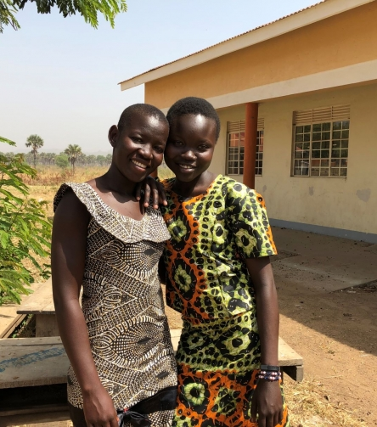
Audience Profile - Adolescent Girls – Not yet Pregnant
Aged 10-14 years
Have not yet given birth.
Faced with early sexual debut and most probably are sexually active.
In school but with a high risk of drop out.
Get most of their information from peers who are equally not knowledgeable.
Have strange relationships with parents and find it hard to discuss sexuality and relationships issues with them
Their safe spaces are school and church.
Naive about body changes and attracted to the opposite sex.
Have many myths and knowledge gaps about pregnancy prevention.
Fear to be judged by old people if they ask about sexuality, FP and pregnancy prevention.

Slide 16
Audience Profile - Adolescent Girls –Pregnant
Aged 10-14 years.
Are pregnant and most likely went for ANC late.
Stigmatized for getting pregnant early.
Have low knowledge on contraception.
Have inadequate knowledge on maternal and childcare and face a lot of pressure from older family members on childcare practices.
Have inadequate knowledge on child and self-care.
Not empowered to seek knowledge and information on health.
Get most of their information from peers who are equally not knowledgeable.
Have strange relationships with parents and find it hard to discuss sexuality and relationships issues with them.
Have no source of livelihood are largely dependent on their male partners and parents.
Not empowered to negotiate safe sex and contraceptive use.
Have many myths and knowledge gaps about pregnancy prevention.
Fear to be judged by old people if they ask about sexuality, FP and pregnancy prevention.
Do not qualify to belong to any support groups.

Slide 17
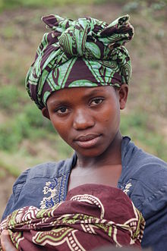
Audience Profile – AGYWs – Have given birth
  Aged 15 – 24 years.
  Have given birth already to one or two children.
  Reluctant to go for early ANC due to bias and peer influence.
  Get most of their information from peers as most of them belong to support groups.
  Majority are not empowered to negotiate safe sex and contraceptive use. Some even experience GBV.
  Likely to be more receptive to PPFP information.
  Most have no source of livelihood are largely dependent on their male partners and parents.
  Most have limited partner support in terms of pregnancy issues.
  Some are not able to recognize danger signs during pregnancy and among children.
  Some have a heavy workload and do not have time for child and self-care.
  Majority have pressure for in-laws to give birth to a second child.

Slide 18
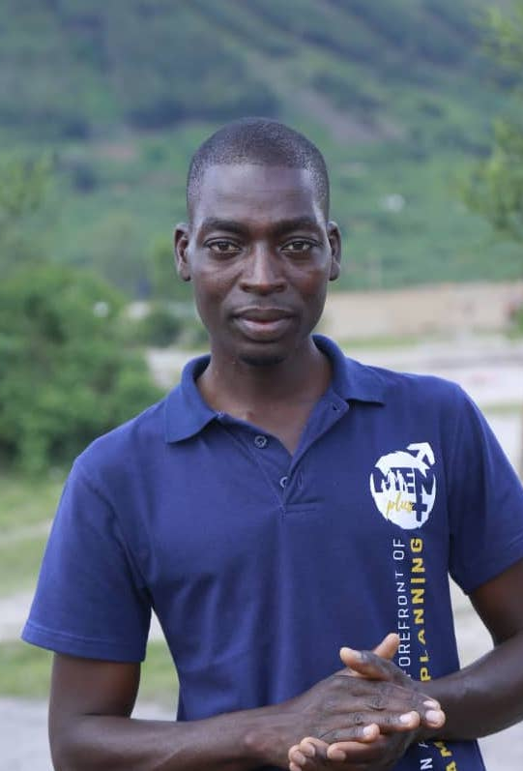
Audience Profile - Men
  Age 15-49
  Low-income earners and unemployed – involved in informal sector employment.
  Unavailable for their partners.
  Lack proper knowledge about pregnancy and MCH issues.
  Most are O’level school dropouts.
  Have multi concurrent partners.
  Low self esteem due to poverty.
  Live in polygamous homes and are most probably co-habiting.
  Some are ready to be parents.
  Perceive male involvement from the economic angle only.
  Perceive pregnancy, maternal and childcare as a woman’s role.

Slide 19
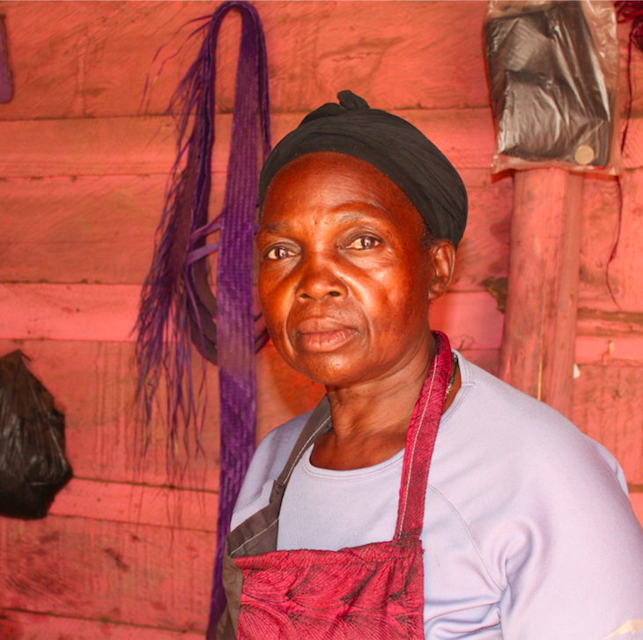
Audience Profile -Older Women and Peers
  Have a lot of myths, misconceptions and wrong information.
  Have had children in the past.
  Have a strong voice in the community, very influential to the young women, what they say stands.
  Young women listen to them out of respect.
  Uphold traditional beliefs.
  Traditional ways have worked for them in the past, so they believe them.
  Not very educated and lack correct information regarding MCH.
  Belong to community support networks.

Slide 20
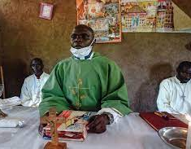
Audience Profile - Gate Keepers
Are highly influential.
Some have inadequate knowledge on FH components.
Some have clouded judgement due to myths and misconceptions.
Some are rooted in social and cultural norms and practices, some of which are barriers to FH components.
Some do not know how to deal with teenagers
Are conservative regarding issues of SRH.
Some are overwhelmed with other priorities other than FH.

Slide 21
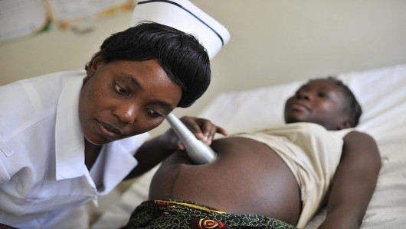
Audience Profile – Health Workers
Very judgmental and rude
Feel like they have adequate knowledge about their work.
Respected sources of information.
Overwhelmed with the client overload.
Equally have knowledge gaps.
Provide scanty information during counselling.
Equally believe in myths and misconceptions.
Not very welcoming to young mothers.
Demotivated because of low pay.
Have missed opportunities for dissemination of correct information.

Slide 22
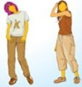


The Life Stage Approach
Family health issues transition along life stages and an outcome from one life stage directly impacts the next. This implies a strong linkage across the life stages thereby justifying an integrated approach in the design and rollout of interventions.
Research has shown that life transitions offer opportunities for positive change, prompting development of new skills, behaviors, roles, and norm definitions as individuals attempt to master the challenges of each new stage.
Therefore, we will leverage the life stage approach that involves the following groups life stage one (young lovers), life stage two (pregnant couples), life stage three (caregivers of children under) and life stage four (adolescents).
Furthermore, this helps to tease out the key priority issues that evolve with transition from one life stage to another.
Lovers/Young Adults in relationships
Pregnant Couple
Caretakers of children U5 (family with children)
Adolescents
Linkage to services

Slide 23
Key Messages for Inclusion – Life Stage One (young lovers in relationships)
Audience | Key Messages
Pre-pregnant women and male partner | Discuss when you would want to start a family with your partner. Discuss the number of children you plan to have with your partner. Seek correct information on how to prepare your body for pregnancy. Start to take folic acid supplements if planning to get pregnant soon.
Religious leaders | Leverage the premarital counselling sessions to: Discuss the importance of preparing for pregnancy for health of mother and children. Importance of child spacing. Emphasize that maternal and childcare is a joint role for men and women.

Slide 24
Key Messages for Inclusion – Life Stage Two (Pregnant Couples)
Sub-theme | Key Messages for pregnant women
Maternal Health | Begin ANC as soon as you confirm that you are pregnant and attend at least 8 times. Test for HIV and other diseases. If HIV positive, take your ARVs as advised by the health worker Learn about and recognize the danger signs during pregnancy. Seek correct information on FP during ANC. Make a birth preparedness plan. Plan to and deliver from a health facility. Know that every pregnancy is different. Seek information about the right method to use in case of a miscarriage. Seek emotional support if stigmatized (specific to 10–14-year-olds).
Nutrition | Learn about and practice good nutrition as taught during ANC. Take your iron and folic acid drugs everyday as told by the health worker.
Malaria | Sleep under a treated mosquito net every night. Take medicine to prevent malaria during pregnancy and complete all doses.
Key Messages for Men | Key LS3 Messages for Men
Men | Support your partner to attend ANC. Go with your partner for HIV testing. Make a birth plan with your partner and save some money for safe delivery at a health facility. Support your partner to return for postnatal care. Provide a variety of food for a healthy pregnancy.

Slide 25
Key Messages for Inclusion – Life Stage Three (Caregivers of Children Under 5)
Sub-theme | Key Messages for women
Family Planning | Discuss with your partner about the available FP options and agree on which one to use within the first 6 weeks after birth. Start to use a FP method with in 6 weeks after delivery. Space the next pregnancy at least 24 months to ensure about three years between births.
Newborn and Childcare | Keep the baby warm and the cord clean. Recognize signs of childhood diseases (pneumonia, diarrhea, malaria, fever) and learn how to manage them. Give ORS and Zinc to a child with diarrhea. Go to the health center as advised and follow the full course of immunization and growth monitoring for the child. Adhere to ART for mothers and children (pediatric ART).
Maternal health | Know the postnatal danger signs. Return to the facility for postnatal care as advised by the health worker. If HIV positive, adhere to ART.
Nutrition | Breastfeed your baby within the first hour of birth. Give your baby breastmilk alone for the first 6 months. Increase the amount and variety of food you eat to produce enough breast milk. At 6 months, start to give your baby a variety of foods at least 3 times a day while continuing to breastfeed. Wash hands with soap and water before preparing or serving food, after using a toilet and after changing diapers.

Slide 26
Key Messages for Inclusion – Life Stage Three (Caregivers of Children Under 5)
Theme | Key Messages
Malaria | Ensure that all children under 5 years sleep under a treated mosquito net. Ensure that children are tested for malaria as soon as they have signs and symptoms. Ensure that children complete malaria treatment even if they feel better. Repair your mosquito net as soon as it gets a tear. Spread the new mosquito net under a shade for 8 hours before use.
Key Messages for Men | Men
 | Help to reduce your partner’s workload to allow enough time for child and selfcare. Provide a variety of food for mother and child. Support your partners and child/children to sleep under treated mosquito nets. Support your partner to use the most suitable FP method available within the first 6 weeks after birth. Support your partner to return to the health facility and complete all immunization appointments.

Slide 27
Key Messages for Inclusion – Life Stage Four (Adolescents - Not yet Pregnant)
Audience | Key SRH Messages – Delaying first pregnancy
Adolescent girls – no child | Seek correct information on how your body grows. Learn how to make good decisions and negotiate what you want to happen to you and your body (Life skills). Delay sexual debut and know the benefits. Seek correct information about preventing unplanned pregnancy. Use a suitable FP method if sexually active. Use condoms if sexually active to prevent HIV and other STIs.
Parents and caregivers | Encourage open dialogue on SRH and body changes. Support adolescents to make informed SRH choices.
Health workers | Provide correct information about body changes and pregnancy prevention. Create a friendly environment for open discussion with adolescents. Support adolescents to make informed SRH choices.
Gatekeepers | Encourage open dialogue between parents/caregivers and adolescents. Organize cultural/religious platforms to discuss SRH issues.

Slide 28
Key FH Messages for Influencing Audiences
Audience | Key Messages
Health workers | Discuss the benefits of full ANC attendance. Talk about HIV testing and its benefits. Give iron and folic acid supplements and discuss their benefits. Discuss good nutrition and the benefits. Discuss the benefits of taking IPTp during pregnancy. Initiate discussion about PPFP during ANC and side effects. Support mothers to initiate breastfeeding within the first hour of birth. Encourage mothers to return to the health facility for check up, full immunization and growth monitoring. Create a conducive and non-judgmental environment for pregnant adolescents (10-14 years). Provide counselling to overcome stigma for pregnant adolescents (10-14 years).
Older women | Communicate correct information about early and complete ANC attendance. Encourage pregnant women to deliver from a health facility. Know and communicate the limitations of giving birth under a TBA.

Slide 29
Key FH Messages for Influencing Audiences
Audience | Key Messages
Gate keepers | Discuss the benefits of early and complete ANC attendance. Talk about pregnancy, maternal and childcare as a joint role for women and women. Encourage families to practice good nutrition especially during pregnancy, breastfeeding and for children. Seek and discuss correct and up-to-date information about the different FP methods and possible side effects. Encourage families to sleep under mosquito nets especially pregnant women and children under 5.
In-laws, family members and peers | Encourage early and complete ANC attendance. Encourage mothers to breastfeed within the first hour of life and give breastmilk alone for the first 6 months. Support to reduce workload so that mothers can have enough time for self and childcare. Prioritize pregnant and breastfeeding women and children in food distribution in the household. Wash hands with soap and water before preparing or serving food, after using a toilet and after changing diapers.

Slide 30

Campaign Tone
Our campaign tone will be:
Reassuring
Empathetic
Factual
Compassionate
Inspiring
Compelling
Triggering a sense of responsibility

Slide 31
Positioning Statement / Key Promise
If you prioritize the health of you family, you will spend less on medical bills.
If you space your births, you will give your baby enough love and care and have enough time to care for your self.

Slide 32
Channels / Interventions Mix
Audience | Channel
Adolescent girls | Peer support groups Digital and social media channels – hotlines, SMS, Facebook, WhatsApp Schools – awareness seminars DREAMS platforms Gate keepers – religious leaders (Channels of Hope), community leaders Parents Very simplified print materials with basic messages on FH and where to seek help IPC – home visits, counselling sessions at the facility, peer counsellors, outreaches, tap into social structures like churches TBAs for early ANC and facility delivery referral
Women of reproductive age (20-49) (pre-pregnant, pregnant, lactating) and other caretakers of children U5 | Women livelihood groups Digital channels – hotlines, SMS Gate keepers – religious leaders (Channels of Hope), community leaders Very simplified print materials with basic messages on FH and where to seek help. Radio -Traditional radio programming (e.g., radio spots, DJ mentions, announcements, jingles, and talk shows) will be used to reinforce key actions IPC – home visits, counselling sessions at the facility, tap into opportunities around the facility childcare, immunization, nutrition sections, ART services, peer counsellors, community dialogues, outreaches, community resource persons, tap into social structures like churches, saving groups, mothers’ union, markets TBAs for early ANC and facility delivery referral Demonstrations – cooking, breastfeeding, net hanging and repair, kitchen gardening

Slide 33
Channels / Interventions Mix
Audience | Channel
Men | Men livelihood groups e.g., boda boda men’s associations Digital and social media channels – hotlines, SMS, Facebook, WhatsApp Gate keepers – religious leaders (Channels of Hope), community leaders, cultural heads Very simplified print materials with basic messages on FH and where to seek help. Radio - Traditional radio programming (e.g., radio spots, DJ mentions, announcements, jingles, and talk shows) will be used to reinforce key actions Gamification - a game to explore negative norms on FH Games in the community to educate people about the forms of FH IPC – home visits, targeted counselling sessions, peer counsellors, community dialogues, outreaches, tap into social structures like churches, saving groups, fathers’ union, markets, values clarification sessions
Peers and older women | Women livelihood groups Digital channels – hotlines, SMS Gate keepers – religious leaders (Channels of Hope), community leaders Very simplified print materials with basic messages on FH and where to seek help. Radio - Traditional radio programming (e.g., radio spots, DJ mentions, announcements, jingles, and talk shows) will be used to reinforce key actions IPC – home visits, counselling sessions at the facility, peer counsellors, community dialogues, outreaches, community resource persons, tap into social structures like churches, saving groups, mothers’ union, markets, values clarification sessions

Slide 34
Channels / Interventions Mix
Audience | Channel
Health workers | Orientation meetings, workshops or seminars Continuous Medical Education (CMEs) Print materials like talking points, facts sheets, job aides Digital tools Values clarification sessions
Gate keepers | Orientation meetings, workshops or seminars Print materials like talking points, facts sheets Cultural and religious platforms Digital tools Community dialogues

Slide 35

Specific Tools and Materials to be Developed
For IPC, the Family Life School (FLS) model (in learning sites) will be the main platform of implementation which leverages existing community structures, enhances peer to peer support, male participation and ownership by all and takes on a multi-sectoral approach.
Since the FH components are interrelated and speak to the same audience, there will be one key tool for IPC ”the wheel of practice” that shall be used within the FLS.
Other tools and materials will include:
  Digital messages like Facebook, SMS, IVR messages etc.
  Talking points for gate keepers
  Job aides for health workers
  Radio materials - radio spots, DJ mentions, announcements, jingles and audience engagement guides, drama series
  Videos
  How to guides on food demonstrations, kitchen gardening, dietary diversity cards, proper net care
  Testimonials from positive deviants and model FLS beneficiaries
  Trigger materials like posters
  Talking points for leaders and champions
  Collateral / promotional materials
  ANC invitation cards for men
  Audience profiling tool
  Milestone tracking tool for both pregnancy and child rearing

Slide 36
About the Wheel of Practice
It is an SBC approach that integrates key FH practices aimed at improving health outcomes for children and women of reproductive age.
It is used by community health workers to conduct negotiated counseling during monthly home visits.
The practices are in pictorial form and laid out in a wheel shape hence the name “the wheel”.
Used by community health workers to conduct negotiated counseling at community level.

Slide 37

Other Creative Considerations
Develop
Develop a male involvement strategy that is based on economic incentives (e.g., better health of the pregnant wife and baby saves money for the man and the household).
Leverage
Leverage other existing community driven initiatives and support networks especially those that have to do with livelihoods.
Promote
Promote aspirations of a happy, healthy family (ensuring that children 0-5 years are healthy, happy, and thriving).
Encourage
Encourage inter-region lesson sharing through the experience lab.

Slide 38






Thank You!

