Slide 1
USAID Social and Behavior Change Activity
Mpox RCCE Response
“Safe Circles” Campaign
October 24, 2024

Slide 2
Background & Rationale
Uganda’s media space continues to be cluttered, making it difficult for generic communication to cut through.
Feedback about social media engagement, especially, has not been very positive; growing numbers on social media has been challenging.
Lessons from COVID-19 and the last Ebola outbreak pointed to the need for a themed campaign that integrates and unifies communication across all channels.
Based on the feedback, many communities have given Mpox many names, making communication challenging.
There’s a need to break down disease science into simple information that people can understand and relate to.
There was a need to find an emotional “hook” that appeals to the different audiences.

Slide 3
Campaign objectives:
Increase knowledge and awareness about Mpox, including addressing emerging rumors, myths, and misconceptions.
Increase Mpox risk perception and trigger public response to the prevention and control measures.

Slide 4
Priority Audiences
Most affected audiences.
Mpox patients, suspects & survivors
Previous contacts with a known cases
Communities in transport corridor & boarder entry points
Transport sector workers
Communities in congregate settings
Traditional healers
Refugee communities
Health service providers
Influencing audiences.
MoH Top Management & PRO unit
Other GoU MDAs
The media
Political, religious, cultural, and opinion leaders

Slide 5
The proposed big idea is “keeping your loved ones safe,” but artistically presented as “Safe Circles.”
The “Safe Circles” campaign uses social circles and community networks to create a collective response to Mpox prevention.
The "Safe Circles" concept encourages individuals and communities to adopt behaviors that protect their immediate social groups, such as friends, family, and close contacts, while supporting others in their broader community.
It leverages the idea that everyone has a role in safeguarding their “circle” from Mpox, promoting trust, solidarity, and shared responsibility.
The “Big Idea”

Slide 6
Key Messages
Your Circle, Your Responsibility: Protect your family, friends, and community by practicing simple preventive measures.
Stay Informed, Stay Safe: Understanding Mpox symptoms, transmission, and prevention helps keep your circle safe.
Small Actions, Big Protection: Individual choices like early symptom reporting, practice of the recommended behaviors, among others can prevent Mpox from spreading within your circle.
Together, We Can Break the Chain: When everyone takes steps to protect their circle, we create a stronger community shield against Mpox.

Slide 7
Executions for various channels and environments…

Slide 8
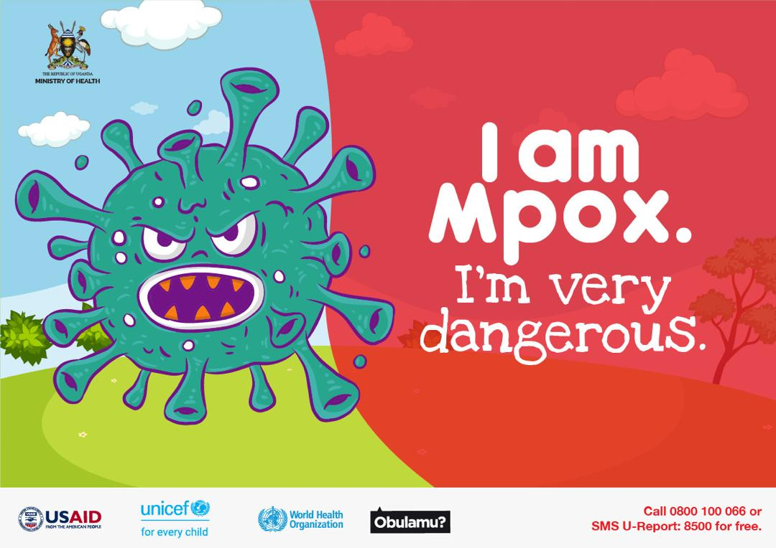
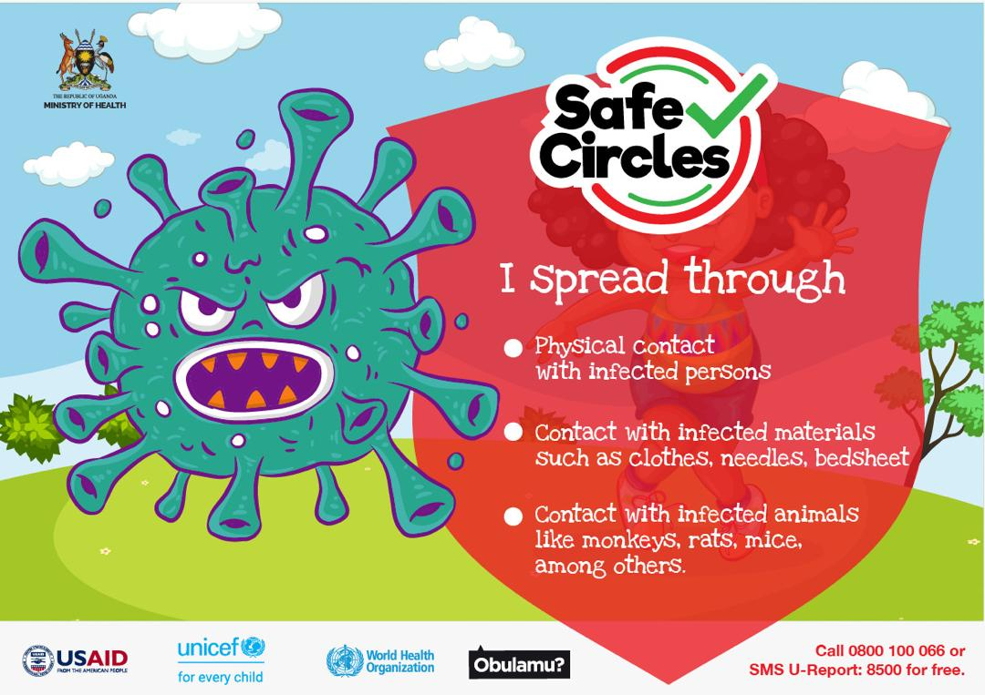
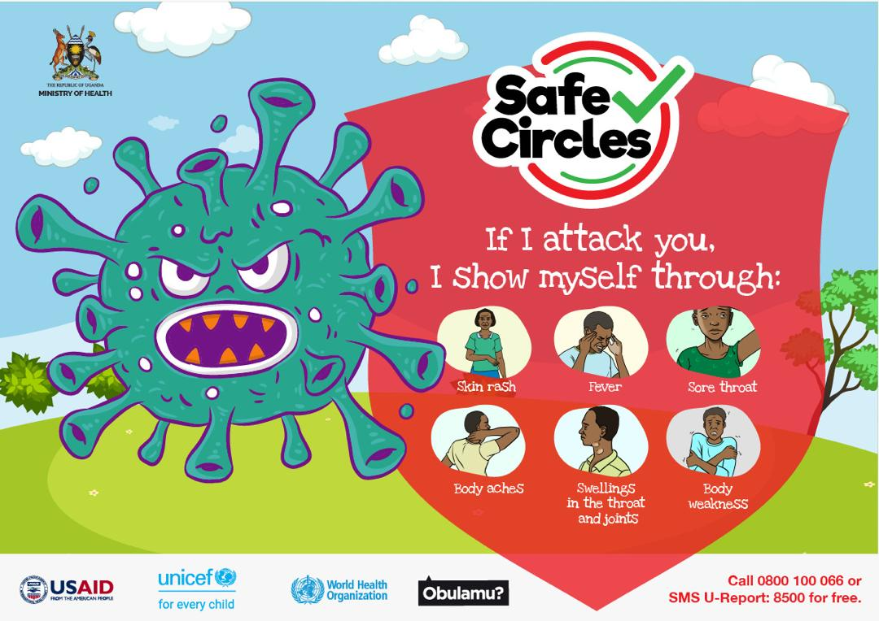
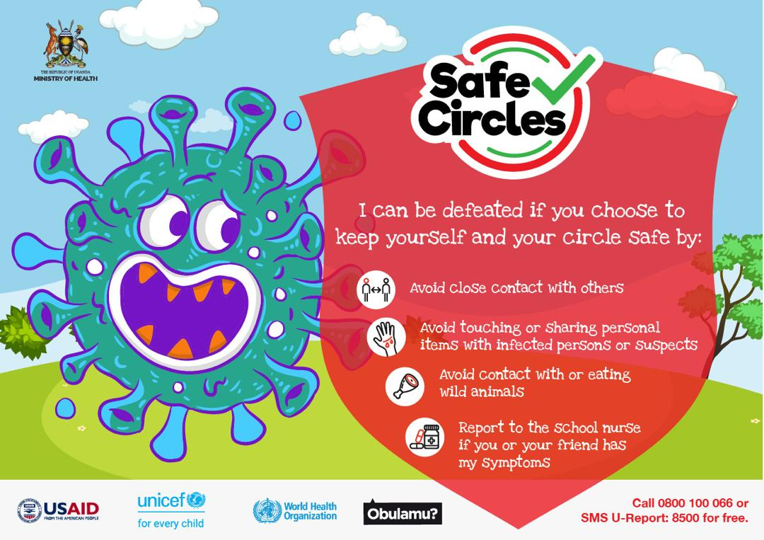
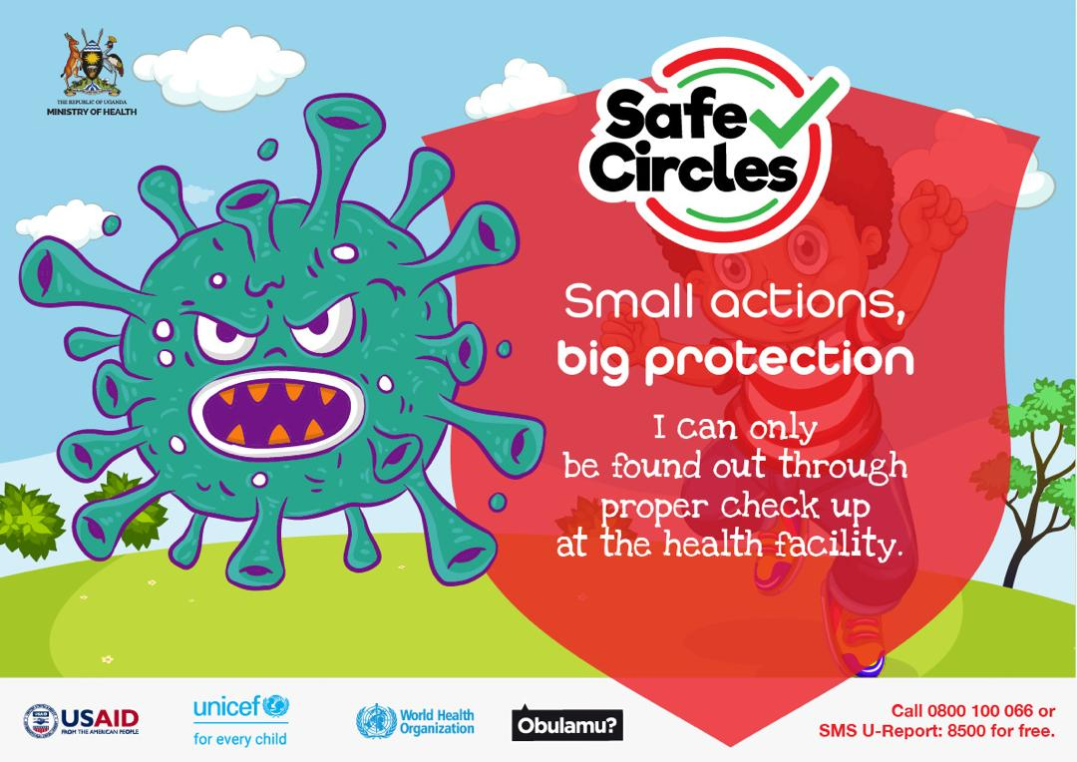
School – Mpox Story

Slide 9
Materials for congregate places like markets, churches, malls, landing sites, points of entry, bus & taxi parks, etc.,
Can be used as posters, billboards, street poles, vehicle stickers, etc.,
SBCA will produce some posters and also place taxis in the affected districts. IPs are expected to scale up.

Slide 10
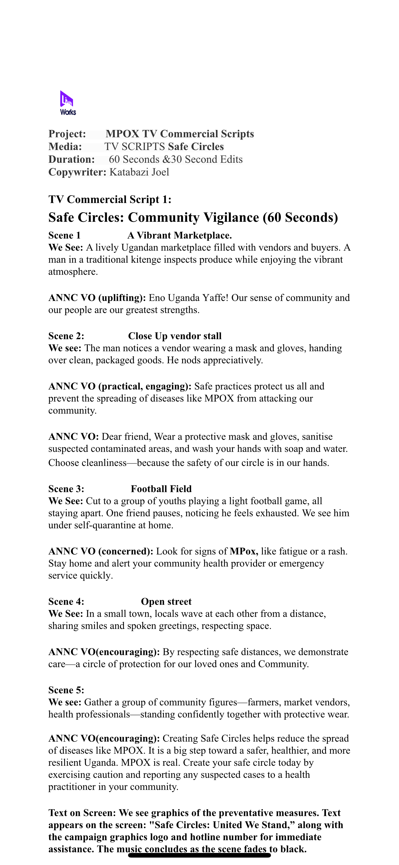
Mass Media
The radio spot will be translated into at least ten languages.
A TVC will be developed after the script is approved and translated into at least five languages.
We propose to record and use testimonies from willing survivors.
Repackage the current videos and align them to the new branding.
SBCA will air these on 45 radio and six TV stations for two months (starts after approval).
IPs are expected to scale these on other stations to achieve the necessary reach and saturation.

Slide 11
Social Media
Leverage popular social media influencers to engage the public.
Social media influencers will customize their content for their audiences.
Continue with engagement sessions on TikTok and X.
Each week will have organized content pillars that reflect the epidemiological trends.
Continue with timely community management to address feedback.

Slide 12
Social Media Cont’d
Social Media Poster 1:
Be the shield your circle needs.
Stay informed. Stay safe. Together, we can stop Mpox.
☎️ Call 0800 100 066 or SMS U-Report: 8500 for free.
Hashtags:
#ProtectYourCircleUg
⁠#SafeCirclesUg
Social Media Poster 2:
Omutonzi waffe yasazewo:
✔️ Wash your hands regularly
✔️ Avoid close contact with anyone showing symptoms
✔️ Visit the health facility if you notice a rash, fever, or swollen lymph nodes.
☎️ Call 0800 100 066 or SMS U-Report: 8500 for free.
Social Media Poster 3
Be the protector in your circle.
If someone has a rash or fever, encourage them to seek care and keep others safe.
☎️ Call 0800 100 066 or SMS U-Report: 8500 for free.

Slide 13
Social Listening
Conduct a weekly online poll.
Conduct a pulse survey at least once a month.

Slide 14
Sample influencer led content

Slide 15
Thank you…

